Slide 1
What's New in Dreamweaver CS4
Steve Drucker
CEO
Fig Leaf Software
Notes:
This presentation describes all the new features in Adobe Dreamweaver CS4.

Slide 2
Topics
New GUI
Code Navigator
New Properties Panel
Related Files Toolbar
Built-in browser (Live View)
Product Documentation now online ONLY
Enhanced Spry/Forms Toolbar
New Spry Dataset Builder supporting HTML Tables
Enhanced JavaScript Support
Web Widgets
In-Context Editing
Direct link to Adobe ConnectNow for Screen Sharing
New Integration Points
Deprecated Functionality

Slide 3
New GUI
Uses the re-engineered interface components that are now common across most CS4 applications
Easier to drag and re-arrange panels
Panels now have a minimized-docked function
Eight default workspaces (instead of designer / coder)
Split Vertical view (design view left, code view right)

Slide 4
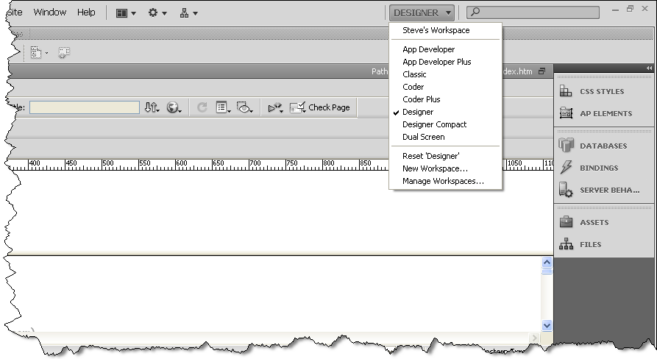
New GUI

Slide 5
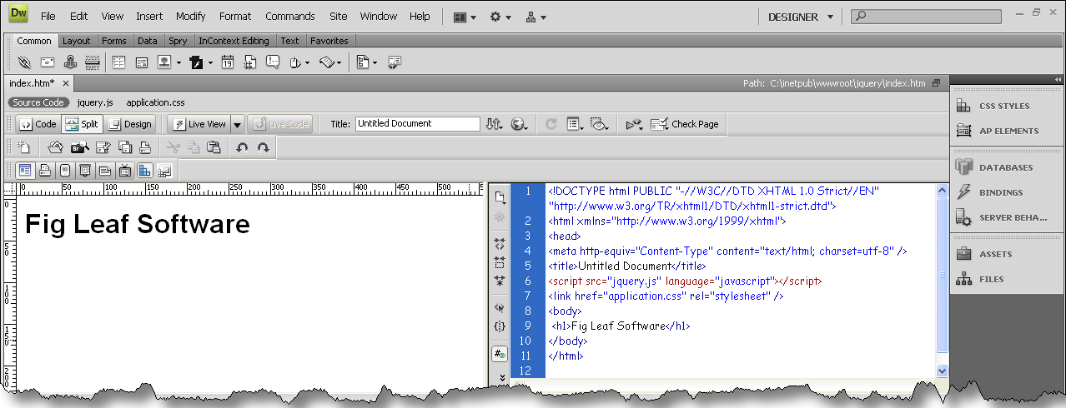
New GUI

Slide 6
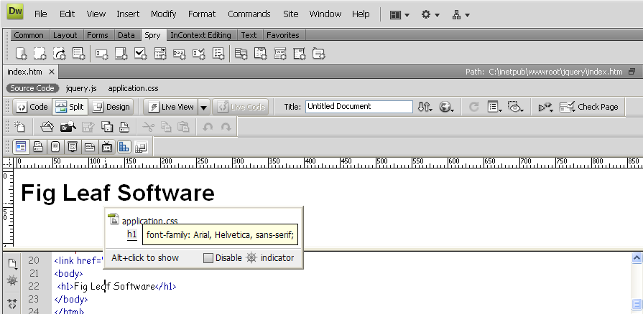
Code Navigator
Hover over items to view how/where their styles are being defined
Hotkey: Ctrl+Alt+N
Note that the same information is available in the Styles Panel

Slide 7
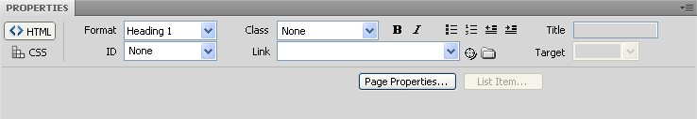
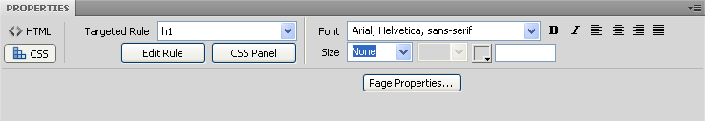
New Properties Panel
Divides up tasks between HTML and CSS
Now creates styles for EVERYTHING

Slide 8
Related Files Toolbar
Opening a html file now opens a secondary toolbar that gives you one-click access to any linked files
  CSS
  JavaScript
Selecting the JavaScript/CSS file can open it in code view leaving design view pointed at the original HTM file
Making changes to the CSS file causes immediate changes to manifest in the Design view

Slide 9
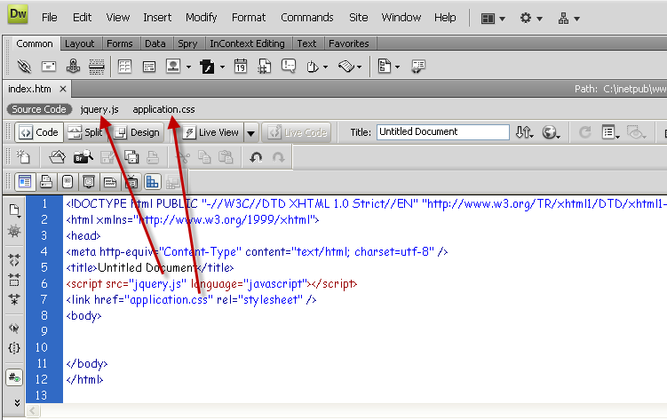
Related Files Toolbar

Slide 10
Built-in Browser
Live View
Based on WebKit Engine
Freeze JavaScript
  Works in conjunction with Live Code
  Enables you to pause JavaScript execution to inspect code
Disable JavaScript
Disable Plugins
Use Testing Server for Document Source
HTTP Request Settings (set form/url variables to preview)

Slide 11
Product Documentation
No longer bundled with the product
You can download the docs as a PDF from Adobe.com
Dreamweaver Help (F1) takes you to the Adobe web site
  http://www.adobe.com/support/dreamweaver/
Dreamweaver Help Search bar takes you to Community Help
  http://community.adobe.com/help/search.html
Product Documentation is here:
http://help.adobe.com/en_US/Dreamweaver/10.0_Using/

Slide 12
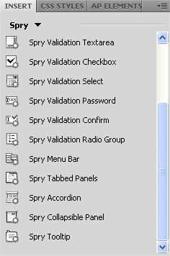
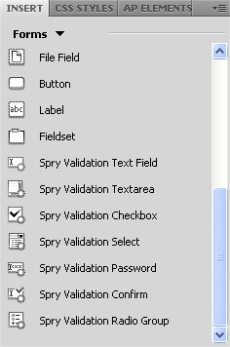
Enhanced Spry/Forms Toolbar
Now fully supports Spry
Form bar button now supports Fieldset
Note: Fieldset does not render accurately in Design View
Support for Spry HTML Data Sets

Slide 13
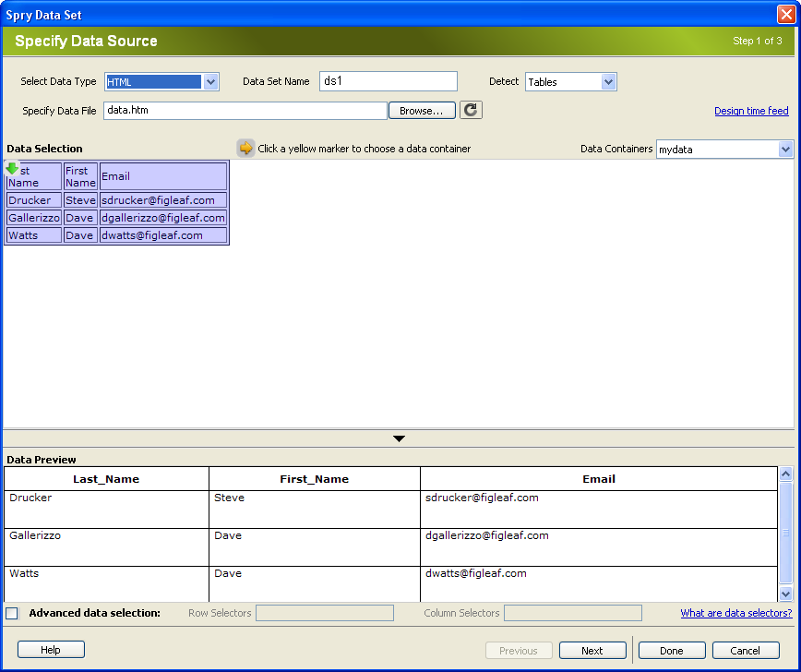
New Spry Dataset Builder
Use HTML files as dynamic data sources!
Read from tables, DIV's, Lists, Custom
Readable objects must have an ID defined

Slide 14
Improved JavaScript Support
Commands > Externalize JavaScript
Code View auto-detects syntax errors
Code view now provides function help for Spry
Code view provides function help for any linked JavaScripts

Slide 15
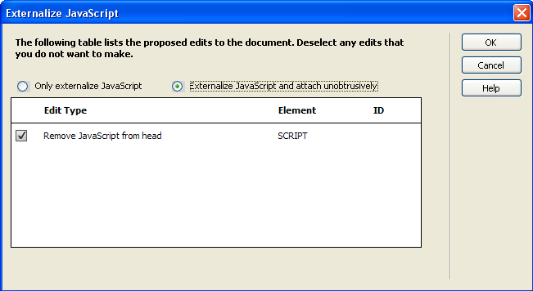
Externalize JavaScript
Collects JavaScript in page and saves as external file

Slide 16
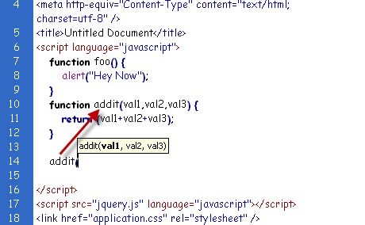
Code Help for JavaScript
Code view interprets linked and embedded scripts
Provides code hinting
Through this mechanism, supports JQuery and any linked library
Built-in dictionary for Spry and DOM

Slide 17
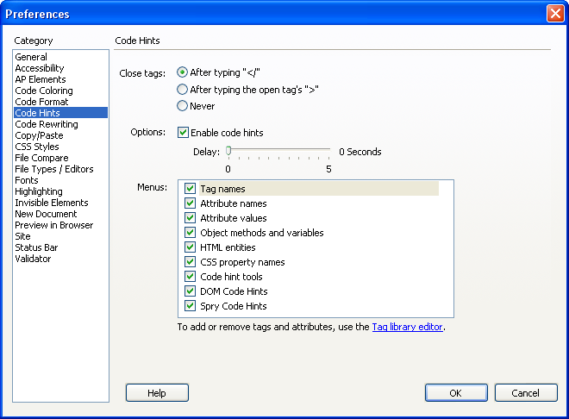
Code Hinting Preferences

Slide 18
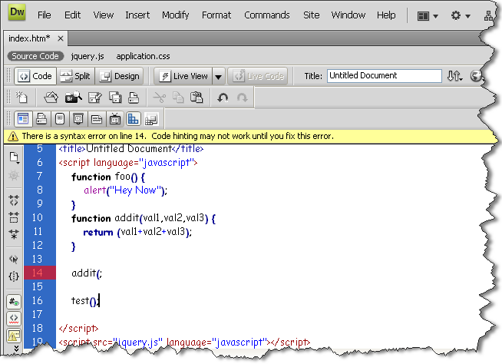
JavaScript Syntax Check

Slide 19
Web Widgets / New Extension Manager
A new open standard for distributing web tools
Web Widget Packager:
http://labs.adobe.com/wiki/index.php/Dreamweaver_Widget_Packager
Widgets
  A XML file that describes the widget.
  WDF File Format
  Works with new extension manager
Web Widgets are available through the Dreamweaver Exchange
  http://www.adobe.com/cfusion/exchange/index.cfm?event=productHome&exc=3
22 web widgets currently available -- focusing mostly on 3rd party AJAX components like the YUI and Google libraries

Slide 20
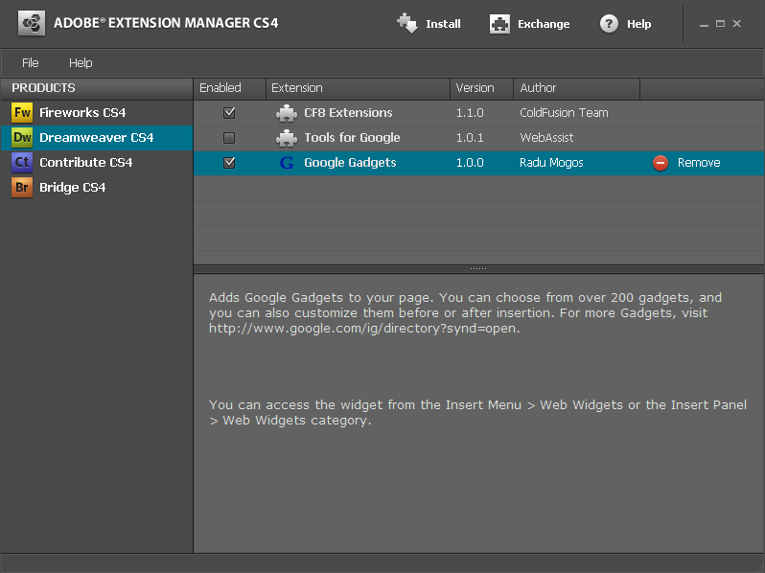
Extension Manager

Slide 21
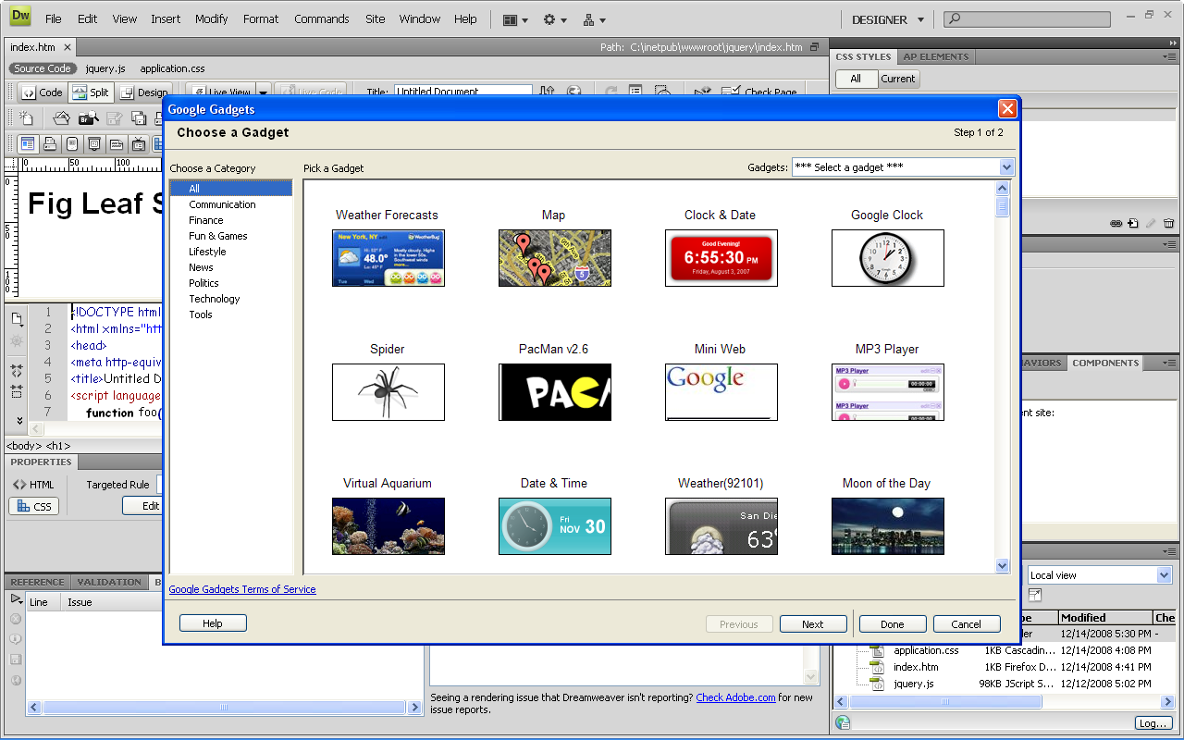
Google Gadget Web Widget
Insert any Google gadget into your web page!

Slide 22
In-Context Editing
Allows you to define editable regions in your web page, similar to using template regions
The content of these regions may be edited by a non-technical contributor through the use of a browser only (Dreamweaver is NOT required)
Uses the Adobe InContext Editing online service
Every editable region must start as a div
Editor is dhtml-based, not Flash-based
You must register your site with Adobe and give it FTP information

Slide 23
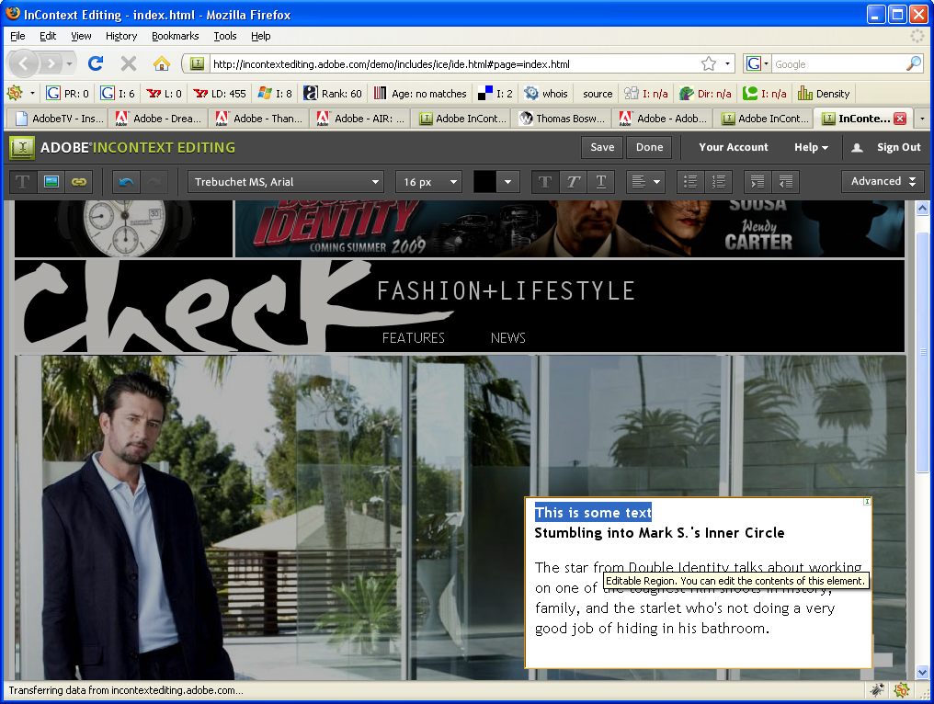
In-Context Editing

Slide 24
Adobe ConnectNow
Formerly Adobe Connect
Now runs much faster w/streamlined GUI in Adobe Flash Player 10
Screen Sharing
White Board
File Sharing
Video / VOIP
Whiteboard
Notes
Connect up to 3 people

Slide 25
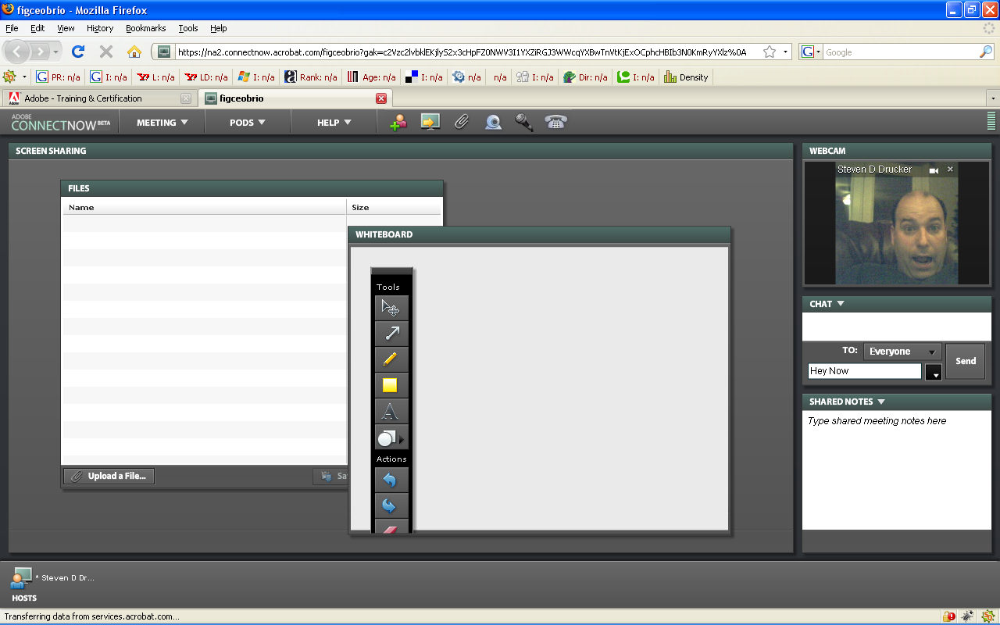
Adobe ConnectNow

Slide 26
New Integration Points
Photoshop Smart Objects
Use the SWFObect 2.0 codebase for embedding SWF
Integration with Subversion

Slide 27
Walkthrough
New Features in Dreamweaver

Slide 28
Deprecated Functionality
Timelines
Web services (excluding CF)
Layout mode
Site Map view
Java Bean support
Adobe® Flash elements (Image Viewer)
Adobe® Flash text and Adobe® Flash buttons
ASP.NET and JSP server behaviors and recordsets

Slide 29
Summary
Plenty of changes for both designers and developers that make it worthwhile to upgrade
Prediction: Expect to see many more Web Widgets make an appearance
Don't forget to consider Fig Leaf Software for all of your consulting/training/product sales needs!
Our Dreamweaver courseware has been newly updated for CS4!

